Slide 1

CSC3170
Tutorial 10
School of Data Science
The Chinese University of Hong Kong, Shenzhen

Slide 2
Overview
Processing Models
  Iterator model
  materialization model
  Vectorization model
Access Methods
  Sequential scan and its optimizations
    Zone MAPS
    LATE MATERIALIZATION
  Index scan
    Multi-Index Scan
2

Slide 3
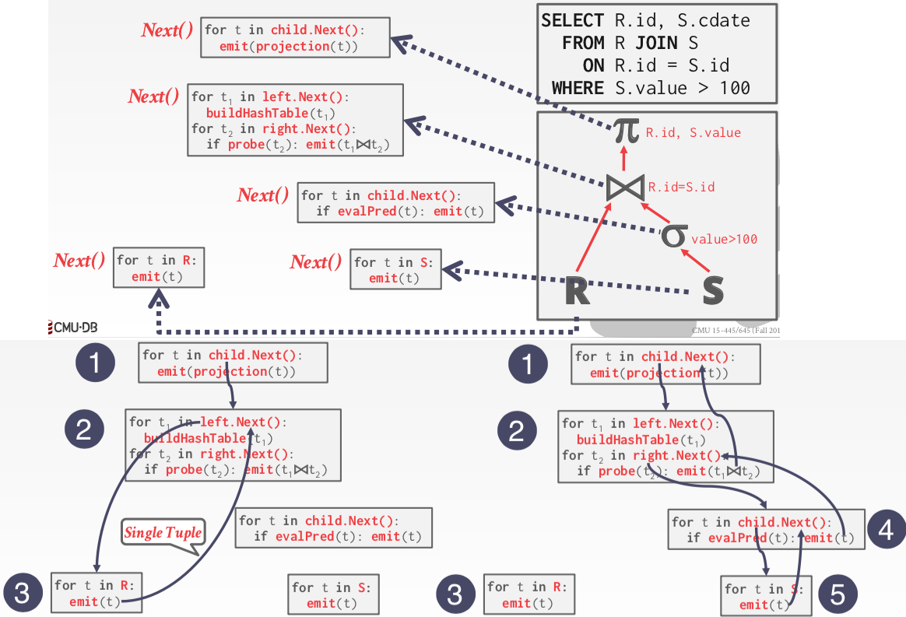
Processing Model: Iterator model
Each operator in the query plan implements a next function.
When called, the next function returns either a tuple or null, with null indicating that all data has been traversed.
Each operator has an internal loop that repeatedly calls the next function of its child operators to retrieve the next piece of data for its own processing.
3

Slide 4
Processing Model: Iterator model
Some operators remain blocked until their children return all tuples; these operators are known as pipeline breakers. Examples include Joins, Subqueries, and Order By operations.
Initial Call to the Join Operator's Next():
The top-level operator (Projection) invokes child.Next() on the Join operator to retrieve the first result.
The Join operator needs to execute its join logic, and for a Hash Join, it must first build a hash table. Therefore, it gets blocked during the build phase.
Building the Hash Table:
During the build phase, the Join operator calls left.Next() (corresponding to the scan operator for R).
Each call to left.Next() retrieves a single tuple.
For each record, the R.id value is added to the hash table until all records from the left subtree (R) are retrieved, completing the construction of the hash table.
4

Slide 5
Processing Model: Iterator model
Entering the Probe Phase:
After building the hash table, the Join operator enters the Probe Phase.
It calls the Next() method of its right child (scan operator for S) to retrieve records.
Processing Filter Condition:
For each record from S, it checks if S.value > 100. If not, the record is discarded. If satisfied, the probe() function checks for a matching R.id in the hash table. If a match exists, the records from R and S are joined, and the result is emitted.
Subsequent Calls:
Further calls to child.Next() do not rebuild the hash table. The Join operator continues probing the right subtree (S) and emits results for matches.
Completion:
When all records from S are processed, child.Next() returns null, signaling the Join operator has finished execution.
5

Slide 6
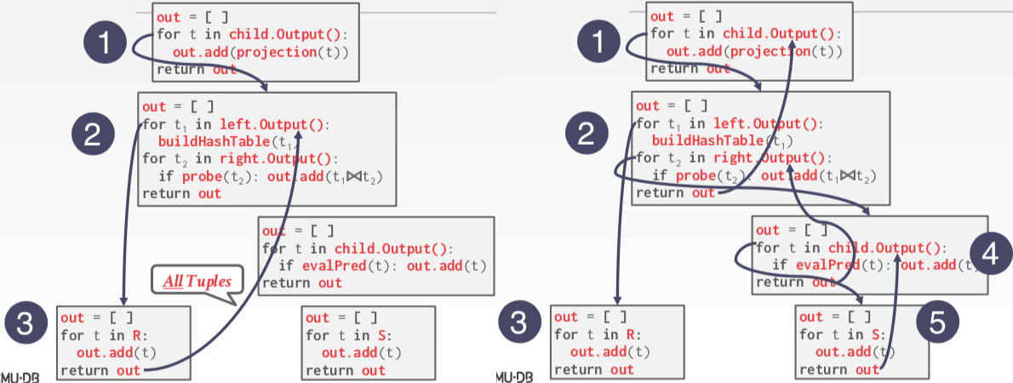
Processing Model: Materialization Model
Each query plan operator implements an Output function:
The operator processes all the tuples of its children at once.
The return result of this function is all the tuples that the operator will emit.
6

Slide 7
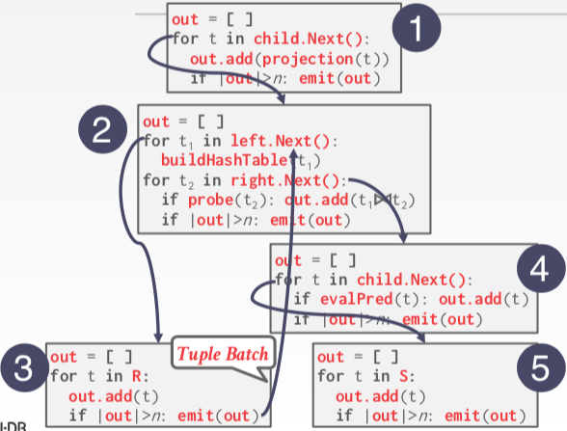
Processing Model: Vectorization Model
Like the Iterator Model where each operator implements a Next() function, but …
Each operator emits a batch single tuple
  The operator’s internal loop processes multiple tuples at a time.
  The size of the batch can vary based on hardware or query properties
7

Slide 8
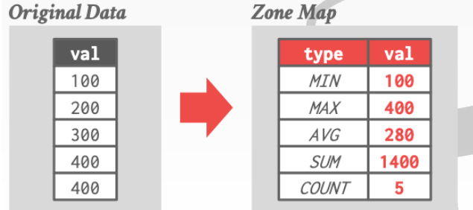

Access Methods: Sequential Scan and Optimization
A sequential scan is the simplest way to retrieve data—it reads tuples sequentially from the pages where the table is stored.
The DBMS uses a cursor to track the position it last accessed (such as the page and slot).
While this method works, it’s often considered the worst-case strategy because it can be very inefficient.
1.Zone MAPS
Pre-computed aggregates for the attribute values in a page. DBMS checks the zone map first to decide whether it wants to access the page.
SELECT * FROM TABLE WHERE val > 500
8

Slide 9
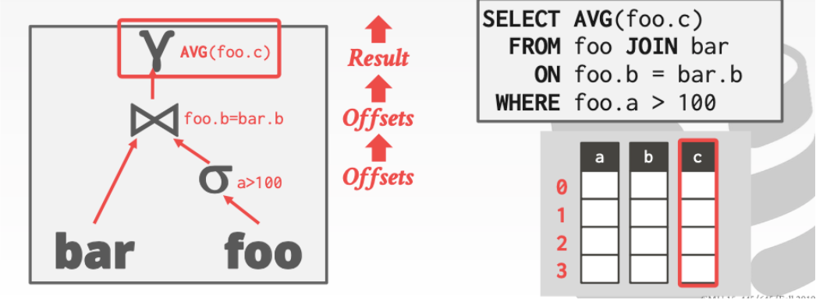
Access Methods: Sequential Scan and Optimization
2. LATE MATERIALIZATION
For columnar DBMS, we can delay passing data from one operator to another.
If a certain column's data is not required further up in the query tree, we only need to pass the offset or the column ID.
This approach allows us to retrieve the necessary data later, only when it is actually needed.
9

Slide 10
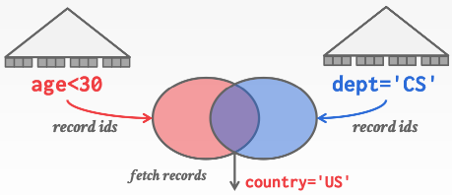

Access Methods: MuIti-index Scan
If there are multiple indexes that the DBMS can use for a query:
Compute sets of Record IDs using each matching index.
Combine these sets based on the query’s predicates (union vs. intersect).
Retrieve the records and apply any remaining predicates
10

Slide 11
Q&A

